Slide 1
Data Fusion Methods for Estimating Funding Impacts on Educational outcomes
CIS - 635
Group: 9
Team Members:
Alysha Nadeem, Ishra Naznin,
MD Imran Khaled, Kenaniah Williams

Slide 2
Introduction

Slide 3
Introduction
Our paper investigates the impact data fusion can have on classification model performance through the lens of how school district funding can determine educational attainment.
Public Education is funded by federal, state, and municipal sources, which are raised via taxes.
Municipalities often use proerty taxes leading to geographic discrepancies in education funding.
Allocated funds are often descripbed in per-pupil terms.
Not all costs that a district face are a direct multiple of the student population.
We intend to test Per-pupil, Overall, and percentage based financials to see which option works best.

Slide 4
Related Work

Slide 5
Related Work
Chango et al. 2021 - Multi-source and multimodal data fusion for predicting academic performance in blended learning university courses
This paper forms the basis of our methodology
The raw data included class performance, online logs, lecture videos, and an interactive session.
That data was process and transformed.
Transformed data was used to train a series of classification models.
The experiment repeated this 4 times with increasing preprocessing.
Meng et al. 2020 - survey on machine learning for data fusion
The authors in this paper are doing a litterature review to better understand the current state of data fusion given the increasing advancements in machine learning.
Focus is on wide application and current technique.

Slide 6
Related Work
Meng et al. 2020 - survey on machine learning for data fusion
They provide a framework of 7 criteria to determine the effectiveness of a data fusion process that we use to inform our evaluation.
Efficiency, Benefit, Stability, Robustness, Extensibility, Privacy, and real-world testing.
Joydeep 2011- Impact of school finance reform on resource equalization and
academic performance
This paper examines the impacts of Michigans Legislative overhaul to school funding that took place in 1994.
The author was able to track school performance overtime to comment on how different cohorts of schools performed overtime.
They found that low performing schools saw the most benefit when funding was equalized, but high performing schools did not decline meaningfully.
Notable that this impact was only seen in state standardized testing and did not extend to the ACT, a national standardized test.

Slide 7
Methodology

Slide 8
Methodology
Data Sources & Fusion Strategy:
Three-Source Integration: Merges district-level data from SEDA 6.0 (Achievement), NCES F-33 (Finance), and SEDA Covariates (Demographics).
Target Variable: Uses Empirical Bayes (EB) adjusted composite scores to represent average achievement.
Competing Funding Formulations: Evaluates three ways to aggregate Source B data: Per-Pupil, Aggregate Sum, and Percentage Allocation.
Data Cleaning: Final dataset of 12,100 districts after filtering for missing values and outliers.

Slide 9
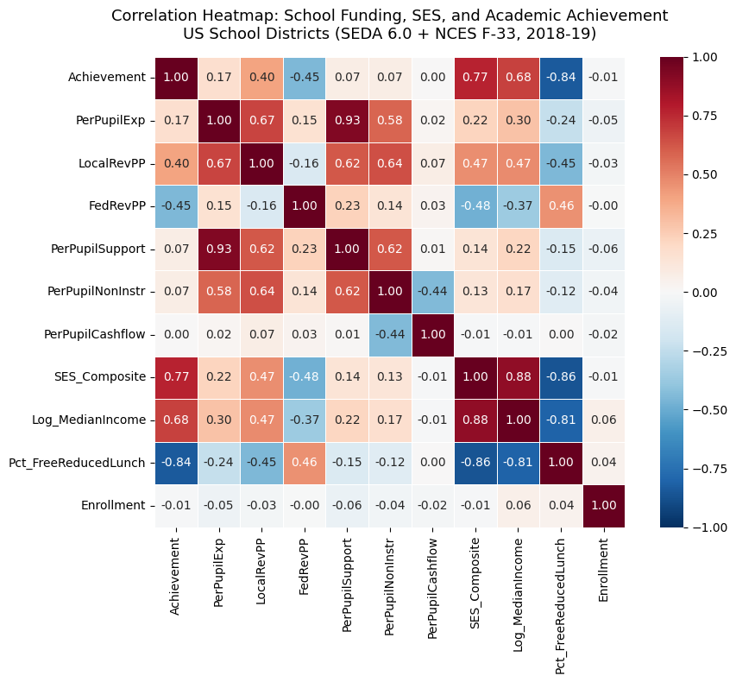

Slide 10
Methodology
Visualization:
Correlation Heatmaps: Used to compare achievement with sub-scores and funding variables.
Key Findings: Achievement showed strong negative correlations with poverty indicators (SES composite).
Revenue Patterns: Local revenue (locrevpp) showed a positive association with achievement; federal revenue showed a negative relationship.
Redundancy Check: Identified perfect correlations between certain spending categories to justify feature removal.

Slide 11
Methodology
Preprocessing:
Numerical Dataset: Features rescaled to a [0, 1] range using Min-Max normalization.
Discretized Dataset: Features binned into 'Low', 'Medium', and 'High' categories using equal-width binning.
Target Variable: The achievement target was binned using tertiles (quantiles) rather than equal-width.

Slide 12
Methodology
Classifier Mapping:
Algorithm Selection: Utilized scikit-learn equivalents of the six Weka-based algorithms from the reference study.
Diverse Model Types: Included Decision Trees, Logistic Regression (JRip), and Neighbors (KNN).
Standardized Hyperparameters: Set specific criteria, such as a max depth of 10 for trees and k=5 for KNN.
Evaluation Method: All models tested using 10-fold stratified cross-validation.

Slide 13
Methodology
Feature Selection:
Technique: Applied SelectKBest to identify the most predictive features
Criteria: Selected features scoring above the mean, capped at a maximum of 5 features.
Statistical Tests: Used ANOVA F-statistics for numerical data and Mutual Information for discretized data.
Application: Selection was applied globally (Exp 2) and independently within each source (Exp 4).

Slide 14
Methodology
Ensemble Fusion:
Decision-Level Fusion: Implemented by training independent models on each data source.
Soft Voting: Combined probability distributions from individual Source A, B, and C models.
Weighting Strategy: Applied a 2:1:2 weight ratio (Achievement:Finance:Demographics).
Rationale: Reflects the higher discriminative power of achievement and socioeconomic data.

Slide 15
Data Preprocessing

Slide 16
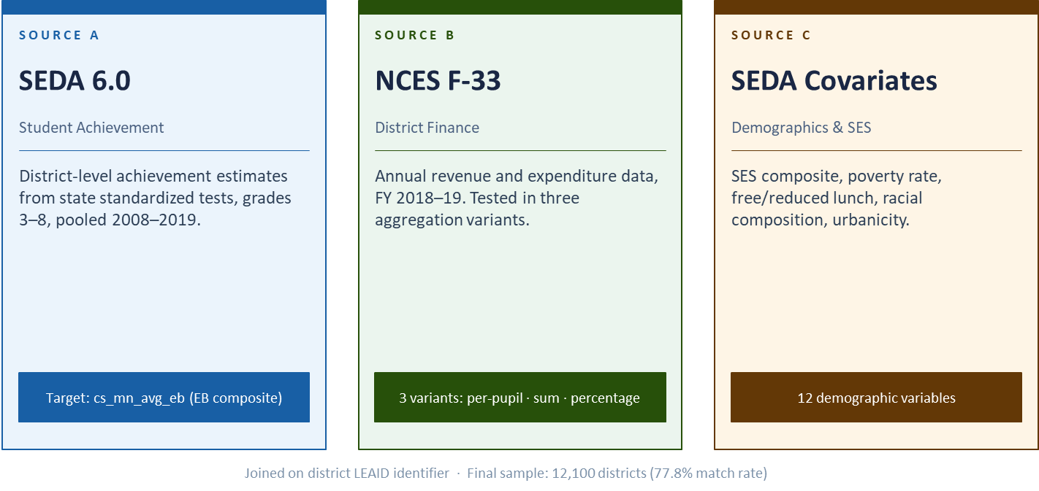
Data Preprocessing
Merging three national datasets into a district-level analytical frame

Slide 17
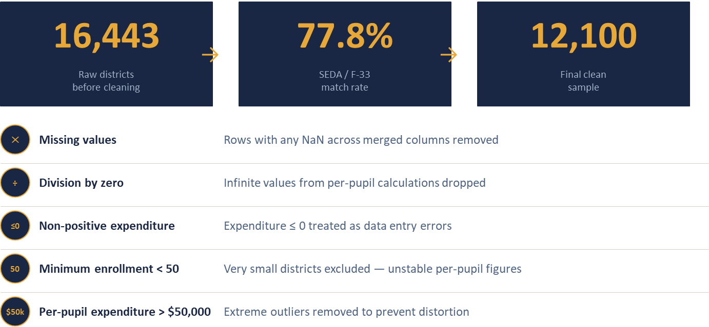
Data Cleaning & Exclusion Criteria

Slide 18
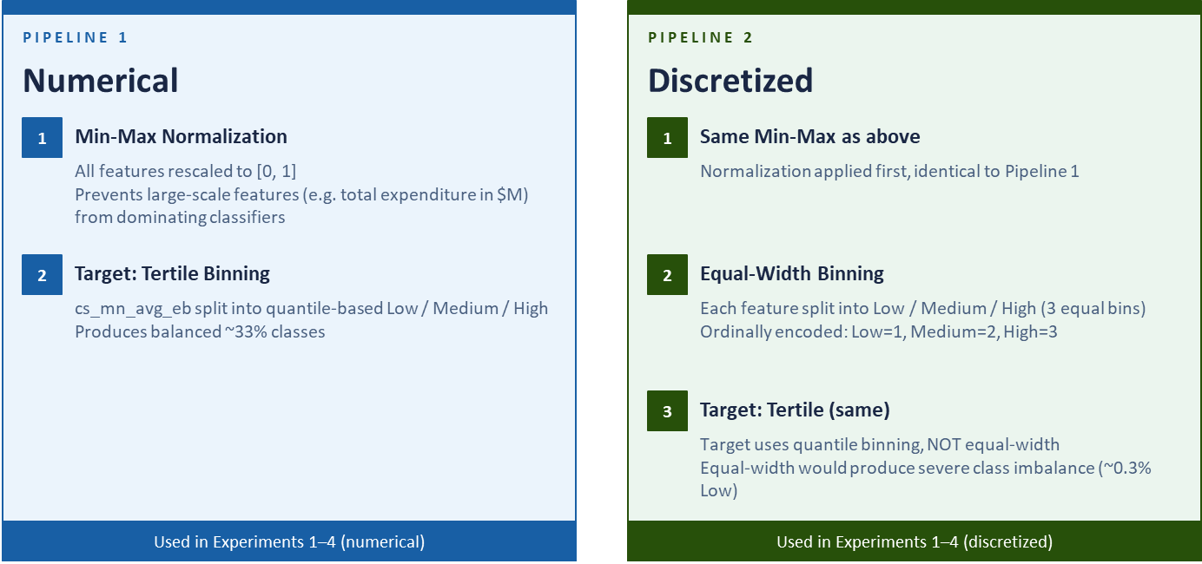
Preprocessing Pipelines

Slide 19
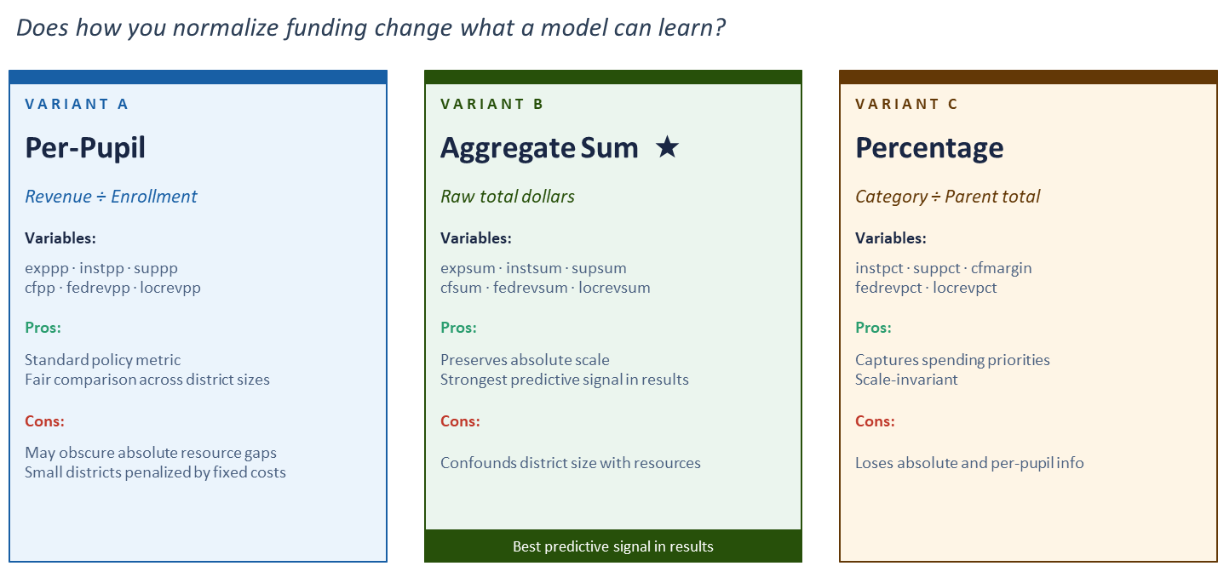
Funding Aggregation

Slide 20
Experiment & Result

Slide 21
Experiment & Result: Overview
Four progressive fusion experiments adapted from Chango et al. (2021)
Experiment 1: Merging All Attributes
Experiment 2: Selecting the Best Attributes
Experiment 3: Using Ensembles (Decision-Level Fusion)
Experiment 4: Ensembles & Selecting the Best Attributes
Data: 12,100 U.S. school districts
Classification Algorithm
10-fold Stratified CV
Evaluation metrics
Accuracy
Area under the ROC curve(AUC)

Slide 22
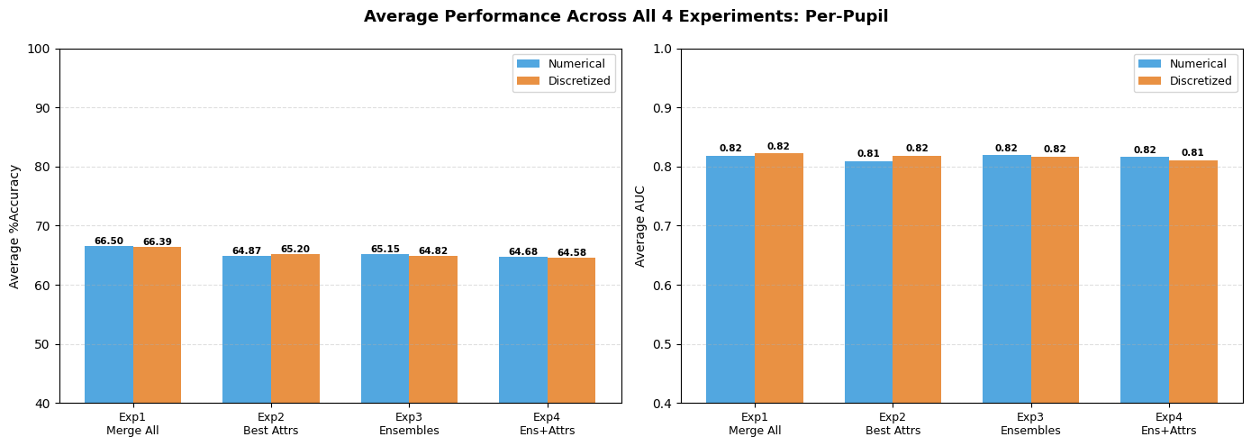
Experiment & Result: Per-Pupil
Test which funding aggregation (Per-Pupil / Sum / Percentage) best predicts the achievement.

Slide 23
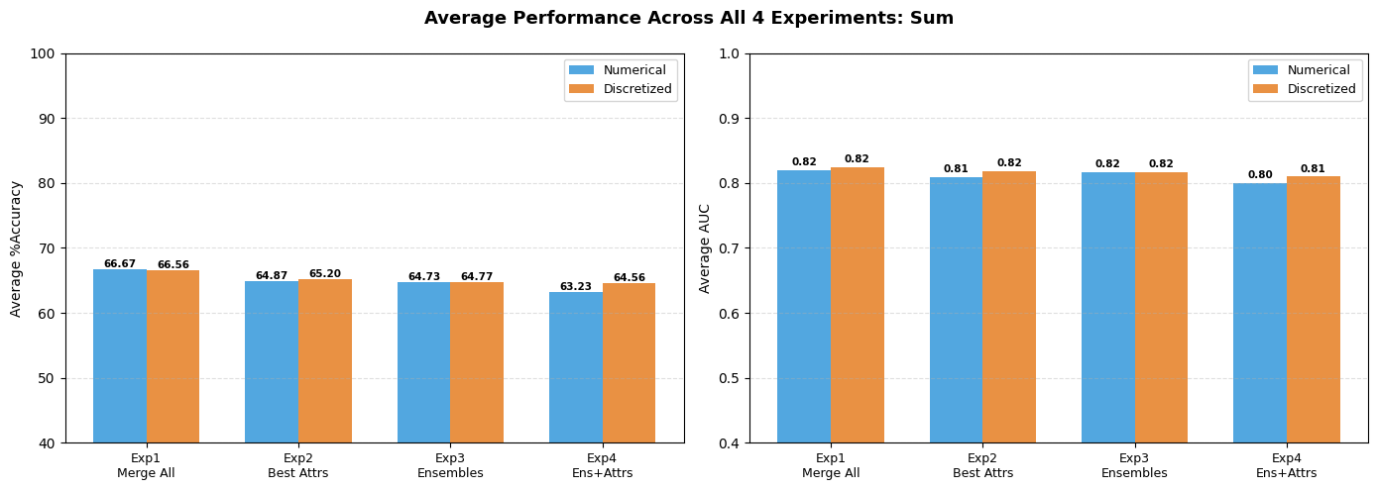
Experiment & Result: Sum
Test which funding aggregation (Per-Pupil / Sum / Percentage) best predicts the achievement.

Slide 24
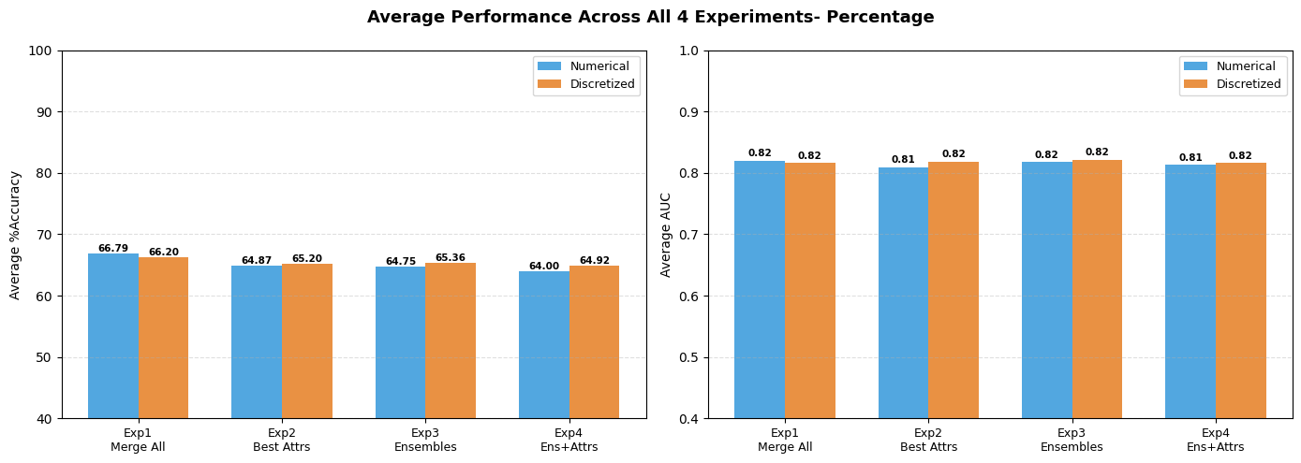
Experiment & Result: Percentage
Test which funding aggregation (Per-Pupil / Sum / Percentage) best predicts the achievement.

Slide 25
Overall Performance Comparison
Best overall: Experiment 1 with Sum Level Funding aggregation
Ranking: Exp 1 > Exp 3 > Exp 4 > Exp 2
Funding Aggregation:
Aggregate Sum consistently best (absolute resource scale preserved)
Per-Pupil second
Percentage worst
Subset selection reduces performance (opposite of Chango et al.)
LogisticRegression shows consistently highest classification performance.

Slide 26
Discussion & Limitation

Slide 27
Discussion & Limitation
Performance & Aggregation:
Performance Stability: All four fusion approaches produced consistent classification accuracies between 66% and 69%.
Optimal Funding Method: The aggregate-sum formulation (Source B_SUM) marginally outperformed per-pupil and percentage-based models.
Value of Absolute Scale: Preserving the raw scale of district resources captures more meaningful variation than over-normalizing data.
Simplest Model Wins: Unlike the reference study, our simplest "naïve-merge" (Experiment 1) remained the most effective.

Slide 28
Discussion & Limitation
Dominance of Socioeconomic Context:
Socioeconomic Dominance: Feature selection consistently retained only Source C variables, such as poverty rates and SES index.
Funding as a Mediator: Finance features only exert influence primarily through their connection to local property-tax capacity.
Policy Implications: Funding reforms are unlikely to shift achievement significantly unless they also address underlying wealth disparities.
Successful Targeting: High federal revenue serves as a marker for high-poverty districts receiving compensatory aid.

Slide 29
Discussion & Limitation
Evaluation Against Fusion Criteria:
Efficiency & Benefit: The pipeline was efficient (single-pass merge) and beneficial, achieving a high AUC of up to 0.86.
Robustness: Discretized data representations consistently outperformed raw numerical data, mirroring previous research.
Extensibility: The four-stage fusion framework is general enough to be applied to other multi-source educational datasets.
Real-World Validation: Unlike synthetic benchmarks, this approach was validated using real-world public administrative data.

Slide 30
Discussion & Limitation
Limitations:
Cross-Sectional Design: The analysis used a single year of finance data (2018-19) against pooled 10-year achievement scores.
Sample Exclusion: Removing small districts (<50 students) may under-represent rural areas with unique funding challenges.
Target Coarsening: Binning achievement into tertiles (Low, Med, High) sacrifices the granularity of continuous scores.
Model Restrictions: Focus was limited to six "white-box" classifiers to prioritize interpretability over raw power.

Slide 31
Conclusion and Future Work

Slide 32
Conclusion & Future Work
Summary:
Study Objective: Adapted the Chango et al. data fusion framework to determine which funding aggregation best predicts district-level achievement.
Sample & Method: Evaluated 12,100 U.S. school districts using six white-box classifiers on both numerical and discretized data.
Top Performing Model: The simplest "naïve-merge" approach (Experiment 1) consistently yielded the strongest results.
Leading Funding Aggregation: The aggregate-sum formulation achieved the highest performance with 68.94% accuracy.

Slide 33
Conclusion & Future Work
Key Takeaways:
Socioeconomic Dominance: Results confirm that socioeconomic variables, particularly poverty markers, overwhelmingly dominate classification.
Local Revenue as a Mediator: Finance features were most meaningful when tied to local revenue, which acts as a proxy for neighborhood wealth.
Methodological Recommendation: Research should prioritize absolute-scale funding variables over over-normalizing data.
Framework Validation: The pipeline satisfied criteria for efficiency, benefit, robustness, and extensibility.

Slide 34
Conclusion & Future Work
Future Work:
Longitudinal Analysis: Moving from cross-sectional data to multi-year panels to model lagged effects and causal dynamics.
Advanced Classifiers: Testing more sophisticated models, such as gradient-boosted ensembles, while maintaining interpretability.
Finer Granularity: Applying the framework to individual school-level data or international datasets.
Hybrid Architectures: Exploring fusion architectures that explicitly weight finance streams by their correlation with local wealth.

Slide 35
References
[1] E. J. Baron, J. Hyman, and B. Vasquez, “Public school funding, school quality, and adult crime,” Review of Economics and Statistics, pp. 1–18, 2026.
[2] W. Chango, R. Cerezo, and C. Romero, “Multi-source and multimodal data fusion for predicting academic performance in blended learning university courses,” Computers & Electrical Engineering, vol. 89, p. 106908, 2021.
[3] T. Meng, X. Jing, Z. Yan, and W. Pedrycz, “A survey on machine learning for data fusion,” Information Fusion, vol. 57, pp. 115–129, 2020.
[4] J. Roy, “Impact of school finance reform on resource equalization and academic performance: Evidence from michigan,” Education Finance and Policy, vol. 6, no. 2, pp. 137–167, 2011.
[5] National Center for Education Statistics, “Common core of data (ccd): Data files,” https://nces.ed.gov/ccd/files.asp, 2024, u.S. Department of Education. Accessed: 2026-03-20.
[6] S. F. Reardon, A. D. Ho, B. R. Shear, E. M. Fahle, D. Kalogrides, and J. Saliba, “Stanford education data archive (version 6.0),” https://purl. stanford.edu/xh833nn4025, 2026, retrieved from Stanford University.
[7] Stanford University, Educational Opportunity Project, “Educational opportunity project,” https://edopportunity.org/opportunity/, 2026, accessed: 2026-04-14.
[8] A. Nadeem, I. Naznin, M. I. Khaled, and K. Williams, “Cis635-project,” https://github.com/alyshain/CIS635-Project, 2026, gitHub repository. Accessed: 2026-04-14.

